Slide 1
Presentation on Naïve bayesian Classification
Presented By:
Ashraf Uddin
Sujit Singh
Chetanya Pratap Singh
South Asian University
(Master of Computer Application)
http://ashrafsau.blogspot.in/
http://www.slideshare.net/ashrafmath/naive-bayes-15644818

Slide 2
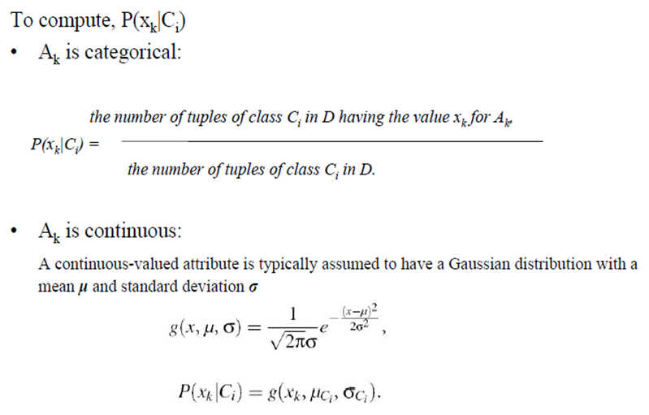
Naïve Bayesian Classifier...

Slide 3
“Zero” problem
What if there is a class, Ci, and X has an attribute value, xk, such that none of the samples in Ci has that attribute value?
In that case P(xk|Ci) = 0, which results in P(X|Ci) = 0 even though P(xk|Ci) for all the other attributes in X may be large.

Slide 4
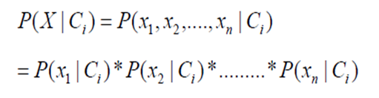
Numerical underflow
When p(x|Y ) is often a very small number: the probability of observing any particular high-dimensional vector is small.
This can lead to numerical under ﬂow.

Slide 5
Basic assumption
The Naïve Bayes assumption is that all the features are conditionally independent given the class label.
Even though this is usually false (since features are usually dependent)

Slide 6
Relevant Issues
Violation of Independence Assumption
Zero conditional probability Problem

Slide 7
Violation of Independence Assumption
Naive Bayesian classifiers assume that the effect of an attribute value on a given class is independent of the values of the other attributes. This assumption is called class conditional independence. It is made to simplify the computations involved and, in this sense, is considered “naive.”

Slide 8
Improvement
Bayesian belief network are graphical models, which unlike naïve Bayesian classifiers, allow the representation of dependencies among subsets of attributes.
Bayesian belief networks can also be used for classification.

Slide 9
Zero conditional probability Problem
If a given class and feature value never occur together in the training set then the frequency-based probability estimate will be zero.
This is problematic since it will wipe out all information in the other probabilities when they are multiplied.
It is therefore often desirable to incorporate a small-sample correction in all probability estimates such that no probability is ever set to be exactly zero.

Slide 10
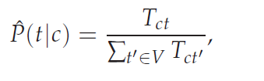
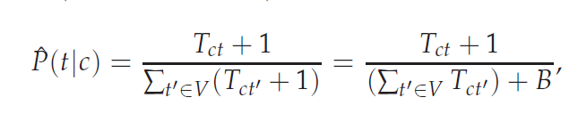
Correction
To eliminate zeros, we use add-one or Laplace smoothing, which simply adds
one to each count

Slide 11
Conclusions
The naive Bayes model is tremendously appealing because of its simplicity, elegance, and robustness.
It is one of the oldest formal classification algorithms, and yet even in its simplest form it is often surprisingly effective.
It is widely used in areas such as text classification and spam filtering.
A large number of modifications have been introduced, by the statistical, data mining, machine learning, and pattern recognition communities, in an attempt to make it more flexible.
but some one has to recognize that such modifications are necessarily complications, which detract from its basic simplicity.

